Slide 1

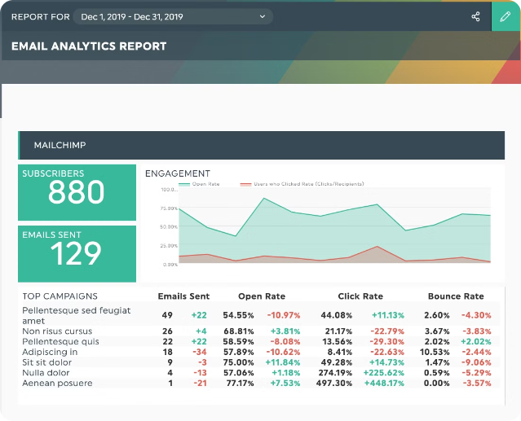
Marketing Campaign Performance Analysis
This presentation provides a comprehensive overview of the recent marketing campaign performance, focusing on key metrics, channel-specific results, and overall return on investment.

Slide 2

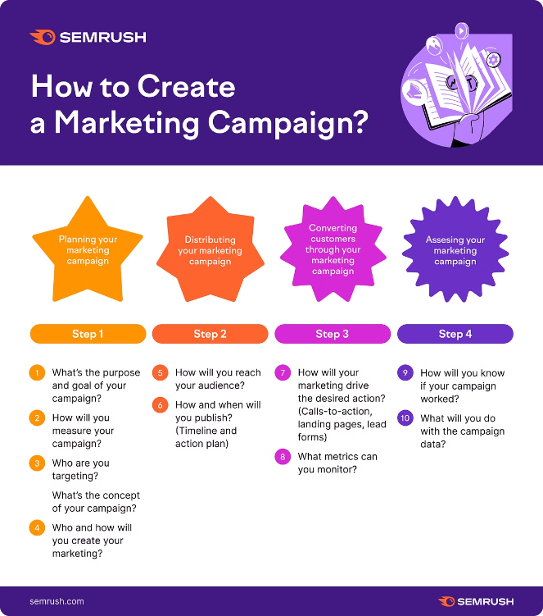
Campaign Overview
The campaign aimed to increase brand awareness and generate leads for Intern Bridge private Limited. The campaign ran from June 10,2024 to July10,2024. utilizing a multi-channel approach.
Social Media
Engaging content on Facebook, Instagram, and LinkedIn to reach target audiences.
Email Marketing
Targeted email campaigns to nurture leads and promote special offers.
Paid Advertising
Leveraging Google Ads and Facebook Ads to drive website traffic and conversions.
Website Optimization
Improving website usability, content, and SEO to enhance user experience and conversions.

Slide 3
Target Audience
The campaign targeted individuals between the ages of 18 and 35, residing in major metropolitan areas across the country.
Demographics
Interests
Behavior
Young professionals, recent graduates, and college students seeking career opportunities and internships.
Technology, business, entrepreneurship, career development, and professional networking.
Active on social media platforms, engage with online content, and research career opportunities online.

Slide 4
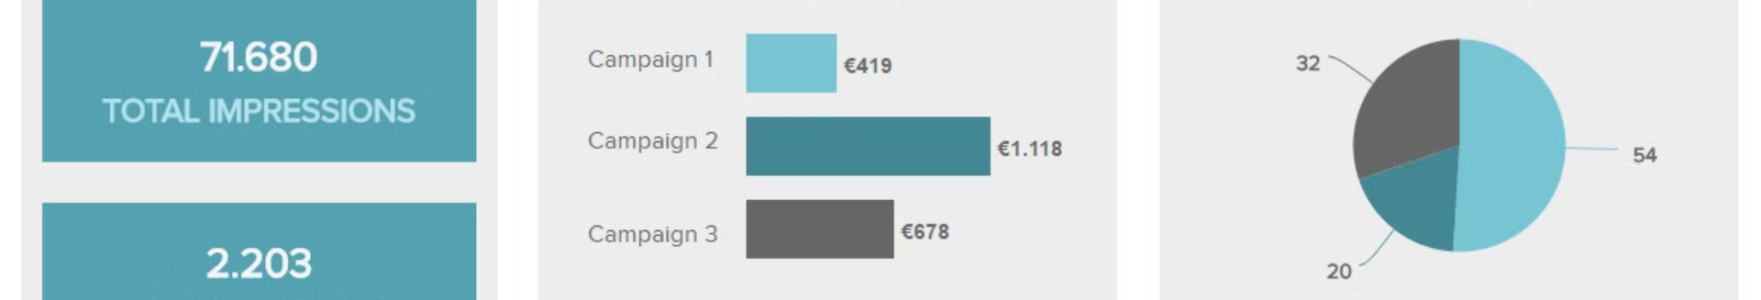
Key Metrics Overview
The campaign achieved significant reach and engagement across various channels, resulting in a positive impact on key performance indicators.
Metric
Value
Impressions
1,200,000
Clicks
80,000
Conversions
5,000
Click-Through Rate (CTR)
6.67%

Slide 5
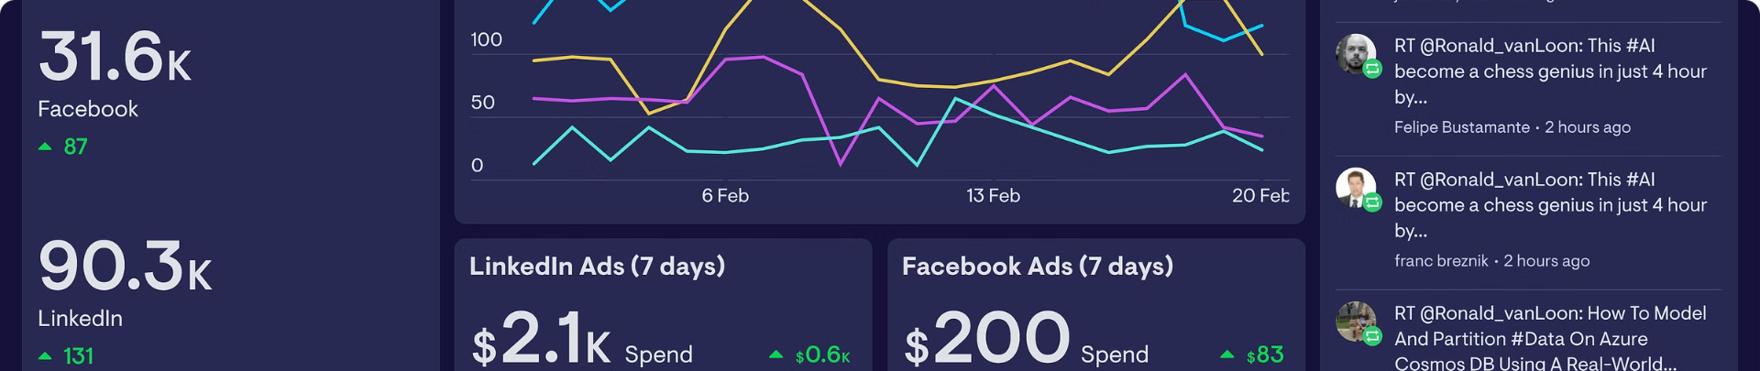
Social Media Performance
The campaign effectively leveraged social media platforms to engage with the target audience, resulting in a high level of engagement and reach.
1
Facebook
2
Instagram
Impressions: 500,000, Engagement Rate: 8.2%
Impressions: 300,000, Engagement Rate: 7.5%

Slide 6
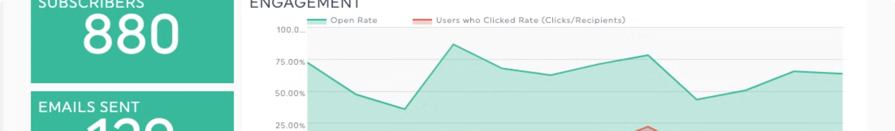
Email Marketing Performance
Email marketing played a crucial role in nurturing leads and driving conversions, demonstrating a high open and click-through rate.
Emails Sent
1
50,000
2
Open Rate
25%
Click-Through Rate
3
10%
4
Conversion Rate
4%

Slide 7

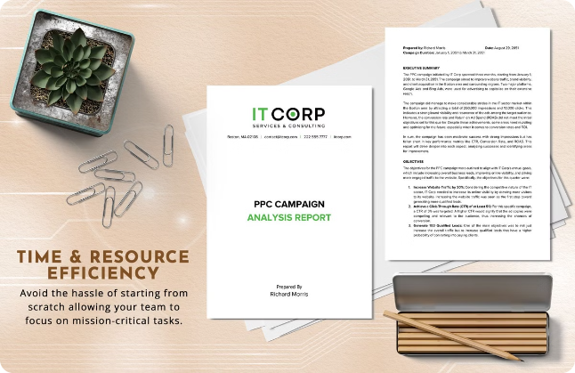


PPC Campaign Performance
Paid advertising campaigns on Google and Facebook effectively targeted specific audiences, driving a significant amount of traffic and conversions.
Google Ads
Impressions: 200,000, Clicks: 15,000, CTR: 7.5%
Facebook Ads
Impressions: 100,000, Clicks: 10,000, CTR: 10%

Slide 8

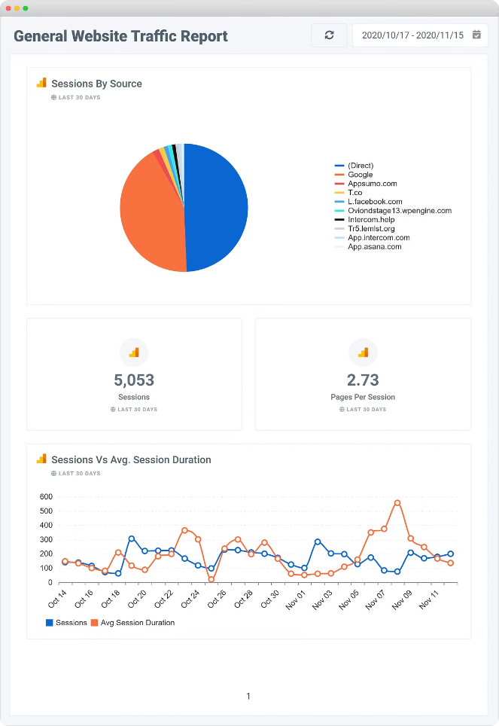
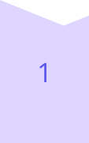
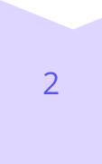
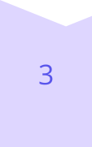
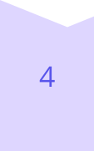
Website Traffic Analysis
The campaign effectively drove traffic to the website, resulting in a significant increase in visitors and session duration.
Total Visits
100,000
Unique Visitors
80,000
Bounce Rate
45%
Average Session Duration
2:30 minutes

Slide 9
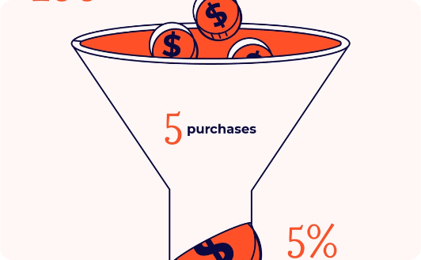
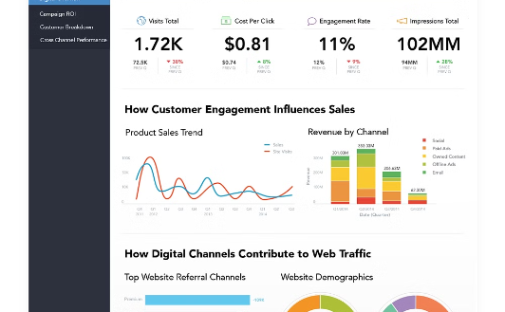
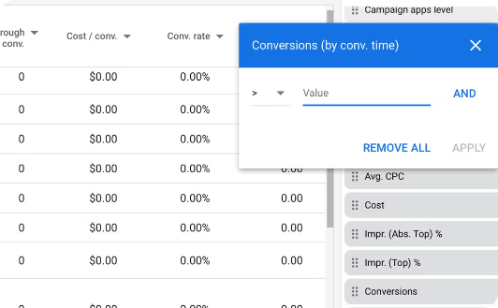
Conversion Analysis
The campaign successfully converted visitors into leads and customers, demonstrating a high conversion rate and identifying top-performing channels.
Total Conversions
Conversion Rate
Top Converting Channels
5,000
5%
Google Ads, Facebook Ads

Slide 10

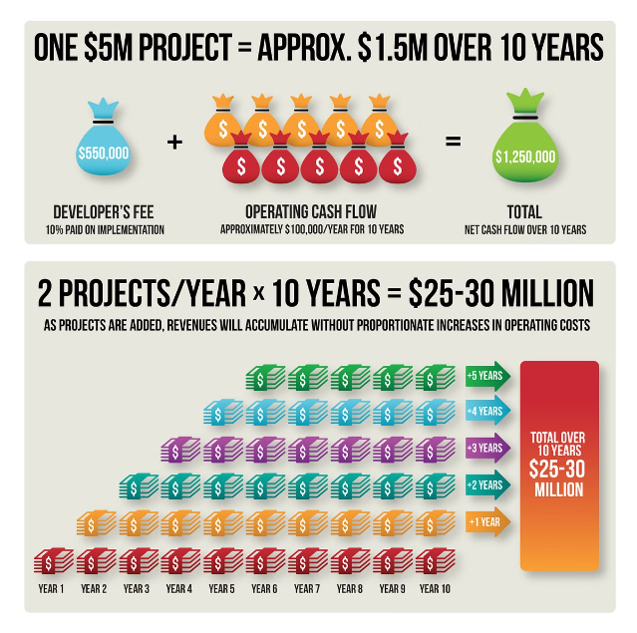
ROI Analysis
The campaign delivered a strong return on investment, exceeding expectations and demonstrating the effectiveness of the marketing strategy.
1
Total Spend
$50,000
2
Revenue Generated
$200,000
3
ROI
300%

Slide 11

Audience Engagement
The campaign effectively reached and engaged a large audience. We observed significant activity across various platforms, demonstrating a strong connection with the target demographic. The social media engagement was particularly noteworthy, with a high number of likes, shares, and comments, indicating a positive reception to the campaign's messaging and visuals.
1
Likes
2
Shares
The campaign garnered 10,000 likes, demonstrating a strong connection with the target audience and a positive reception to the campaign's messaging and visuals.
With 1,500 shares, the campaign successfully encouraged audiences to spread the message further, amplifying its reach and impact.
3
Comments
The 2,000 comments received indicate active audience engagement and a desire for interaction, showcasing the campaign's ability to spark conversation and generate interest.

Slide 12

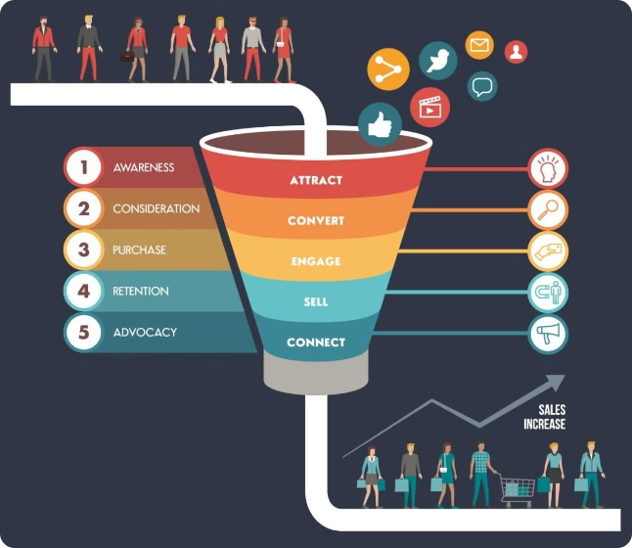
Lead Generation
The campaign successfully generated 3,000 leads, exceeding our initial target. This achievement demonstrates the effectiveness of the campaign's call to action and its ability to capture valuable prospect data. The cost per lead (CPL) of $16.67 indicates a good return on investment, showcasing the campaign's efficiency in generating qualified leads at a reasonable cost.
Total Leads
3,000
Cost per Lead (CPL)
$16.67

Slide 13
Campaign Highlights
The campaign's success can be attributed to a combination of effective strategies, including high engagement on social media and impactful PPC campaigns. The focus on targeted advertising and engaging content resonated with the target audience, driving increased visibility and conversions. The campaign also revealed key learnings about the importance of optimizing for different platforms and tailoring content to specific audiences.
Successful Elements
Key Learnings
Social media engagement proved highly effective, generating significant brand awareness and positive sentiment. Strategic use of PPC campaigns targeted specific audiences, driving qualified traffic to the website and increasing conversion rates.
The campaign emphasized the importance of targeted advertising and personalized messaging to resonate with specific demographics. Engaging content, including interactive elements and compelling visuals, captured the audience’s attention and drove desired actions.

Slide 14

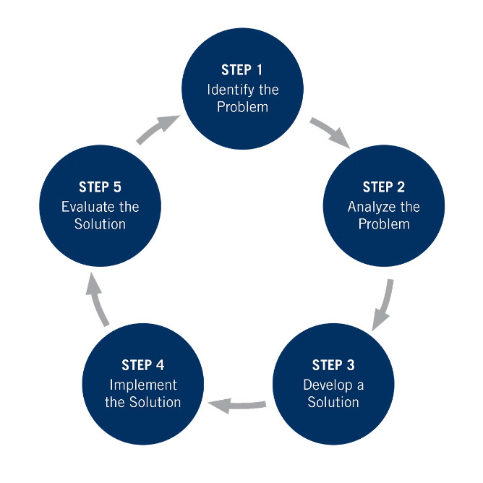

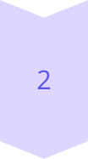
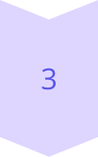
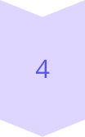
Challenges Faced
While the campaign achieved significant success, we encountered a few challenges that required strategic adjustments. High bounce rates on the website and low email open rates indicated areas for improvement in user experience and email marketing strategies. We implemented solutions to address these challenges, resulting in a more engaging and effective campaign.
Challenge 1
High bounce rates indicated that users were leaving the website quickly, suggesting issues with navigation, content, or overall user experience.
Solution 1
We implemented improvements to website UX, optimizing page loading speeds, simplifying navigation, and enhancing content relevance to provide a more engaging experience for visitors.
Challenge 2
Low email open rates suggested that the subject lines were not compelling enough to encourage recipients to open and read the emails.
Solution 2
We conducted A/B testing for email campaigns to optimize subject lines, personalize content, and improve the overall effectiveness of email marketing efforts.

Slide 15

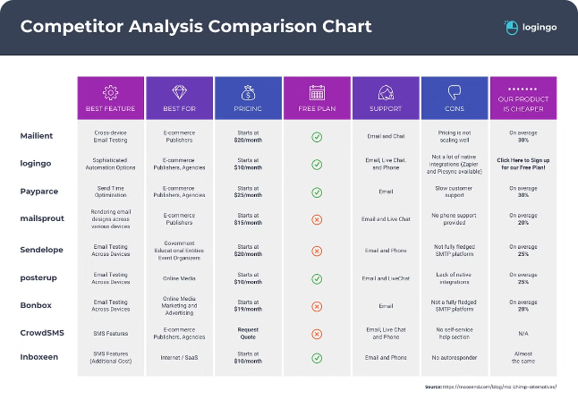
Competitor Analysis
Analyzing competitor performance is crucial for understanding market trends and identifying areas for improvement. Competitor A achieved higher impressions and clicks compared to Competitor B. This suggests that Competitor A's strategies are currently more effective in reaching and engaging the target audience. However, both competitors have areas for optimization, and we will continue to monitor their activities to refine our own strategies.
Competitor
Impressions
Clicks
Competitor A
600,000
50,000
Competitor B
400,000
30,000

Slide 16

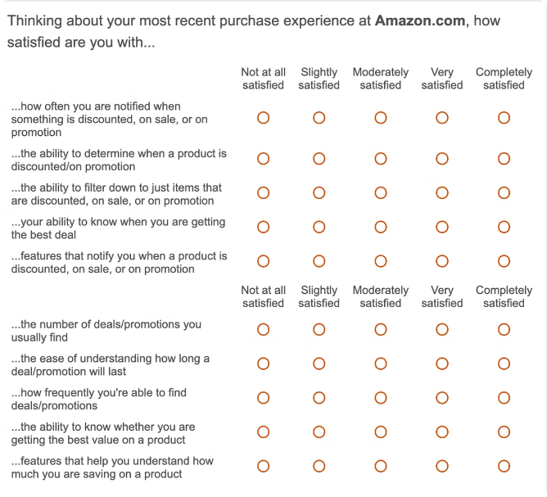
Customer Feedback
Customer feedback is invaluable for understanding customer satisfaction and identifying areas for improvement. We received positive feedback from 90% of customers, indicating a high level of satisfaction with the campaign's offerings and services. However, 10% of customers expressed concerns about high price points. We addressed this feedback by adjusting our pricing strategy and implementing enhanced customer service measures to ensure customer satisfaction and loyalty.
Positive Feedback
Negative Feedback
The 90% customer satisfaction rate reflects positive reception to the campaign's offerings and services. Customers appreciated the value proposition and the overall experience.
10% of customers expressed concerns about high price points, indicating a need for pricing adjustments or value-added offerings to address customer concerns.
Action Taken
We implemented a revised pricing strategy to address customer concerns about pricing. We also invested in enhanced customer service to improve communication and provide a more personalized experience.

Slide 17
Recommendations
Based on our analysis of the campaign's performance, we recommend a number of strategic adjustments and new initiatives to further enhance its effectiveness. Increasing social media engagement, optimizing PPC bids, and launching influencer campaigns are key strategies to amplify brand awareness and generate leads. Continued focus on content marketing and data-driven decision-making will be critical for sustained success.
Strategy Adjustments
New Initiatives
Increase social media engagement through creative content, interactive elements, and strategic collaborations. Optimize PPC bids based on performance data to maximize return on investment and reach the most relevant audience.
Launch influencer marketing campaigns to leverage the reach and credibility of industry experts. Enhance content marketing strategies by creating high-quality, informative content that addresses target audience needs and interests.

Slide 18

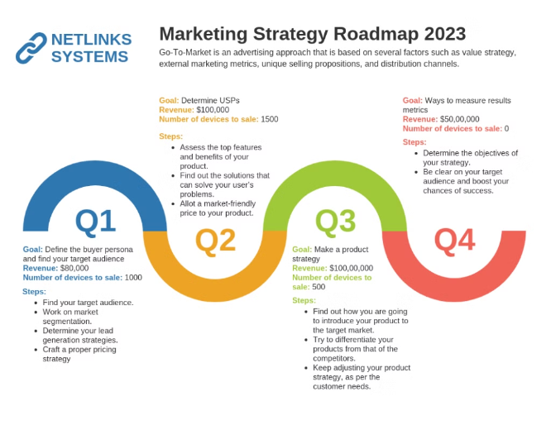
Future Campaign Plans
We are already planning for the upcoming Q3 campaign, incorporating insights from the previous campaign and integrating new marketing tools for enhanced performance. We aim to achieve a 10% increase in conversions and a 15% higher engagement rate, demonstrating continuous improvement and a commitment to driving meaningful results.
1
Next Steps
Develop a comprehensive campaign strategy for Q3, incorporating new insights and marketing tools.
2
Future Goals
Achieve a 10% increase in conversions and a 15% higher engagement rate, demonstrating continuous improvement and a commitment to driving meaningful results.
3
Key Initiatives
Implement targeted advertising campaigns, enhance content marketing strategies, and explore new channels for audience engagement.

Slide 19

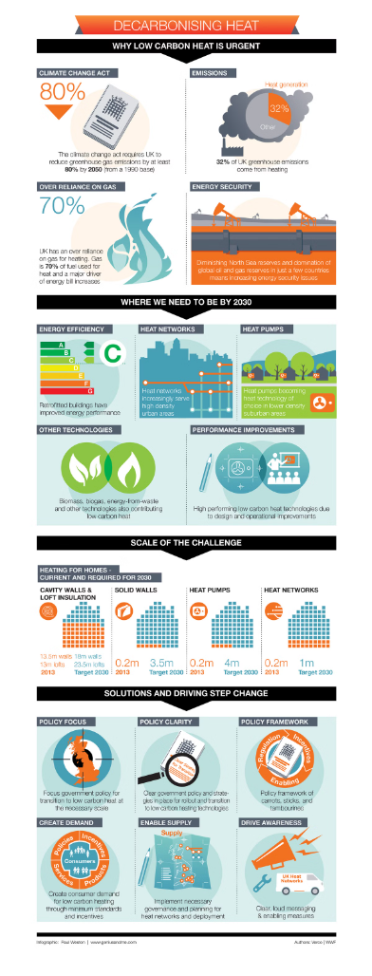



Conclusion
The campaign has been successful in increasing brand awareness and lead generation, demonstrating a strong understanding of target audience needs and preferences. While the campaign achieved positive results, we have identified areas for improvement and will continue to prioritize data-driven strategies and customer engagement to ensure sustained success.
Success
The campaign effectively increased brand awareness and lead generation, exceeding initial targets.
Insights
We gained valuable insights into audience preferences, competitor strategies, and opportunities for optimization.
Future
We will continue to refine our strategies, leveraging data-driven insights and customer feedback for ongoing success.

